Slide 1
Eskom wheeling service
April 2025

Slide 2
What is Wheeling?
An action of transporting electricity from a generator to a load via a third-party network.
The third-party is the licensed Distributor (Eskom or a municipal distributor)
A service enabling customers to receive electricity not supplied by the licensed Distributor;
And using the Distributor's (or Transmission) grid to deliver the energy.
Enables IPPs to generate renewable energy where the resources are located and supply end users in other locations.
Motivated by the market and regulatory context:
Customers need for renewable energy.
Enabling non-discriminatory access to Distributor’s networks.
Need to increase available generation capacity on the grid.
Bilateral Power Purchase Agreement (PPA)
Off taker(s) / Distributor’s customers
Generators
/ Traders
Distributor

Slide 3
Wheeling – How it works
1. The generator apply to Eskom for grid connection, pay the applicable connection charges and signs the connection and use of system agreement.
3. A Generator use of system service agreement is created on the billing system to raise charges based on the MEC. The energy exported is credited on the nominated offtaker’s account.
4. The Offtaker signs an amendment agreement to their supply agreement to account for the wheeled energy
6. No need for a quote on the load side, unless if an upgrade or downgrade is required then normal quotation process for change in supply will apply.
7. Having a wheeling agreement in place does not exempt the customer from load shedding.
2. The generator nominates the offtaker/s in their connection and use of system agreement
5. A separate service agreement is raised on the load account to subtract the wheeled energy using the NERSA approved Gen-wheeling tariff. The customer will still pay standard tariffs for the load supply.

Slide 4
Wheeling conditions Connections and contracting
Generators obtain the required registration with NERSA.
Generator must apply to Eskom for grid connection, request and make applicable payments for:
1) Cost estimate letter to be issued
2) Quotation to request the budget quote
3) Connection charges as quoted in the budget quote.
Generator must be legally connected to an Eskom grid at MV or HV.
Generators must sign the connection and use of system agreement and nominate the off-taker(s).
The load accounts receiving energy, must be connected at MV or HV, must be on a time of use tariff and sign an amendment agreement to enable the wheeling transaction (wheeling credits to be provided)
The buyer/off-taker can be another Eskom customer, a municipality or a customer within a municipality network.
Where one of the parties buying the energy are located within a municipal network, the municipality would have to agree to allow the wheeling transaction.
Currently limited to generators/loads connected >= 1 kV

Slide 5
Wheeling conditions Credits, nominations, forecasts and contract duration
To enhance efficiency and sustainability, conditions for wheeling now include:
Payments and wheeled energy credits
Generator and Off-taker previous month bills to be settled in full for wheeled energy credits to be provided.
A generator can pay for costs associated with wheeled energy on behalf of the offtaker by contracting for Wheeling on the generator billed (Gx-billed) option.
Cut-off for nominating wheeled energy allocations
Generators can nominate different offtakers for Eskom to allocate the wheeled energy.
Generators are required to submit their updated nomination and allocations to Eskom at least 24 hours before the billing date.
Forecast requirements for wheeled energy
The generator exporting energy for wheeling and off-takers / customers are both required to provide a 3-year wheeled energy forecast by time-of-use and month.
The forecast must be updated and submitted bi-annually by 30 April and 31 October.
Agreement duration
Customers are required to specify the end date of their wheeling agreement for Eskom’s planning purposes.

Slide 6
Wheeling tariffs and contracts
A generator contracts with a Distributor’s customers to sell its energy through a power purchase agreement (PPA).
The Generator contracts with Eskom for connection through a connection and use of system agreement (CUOSA) and has a gen-duos service agreement.
The applicable generator tariffs are Gen-DUoS and Gen-TUoS; UOS stands for use of system.
Eskom transports the energy using its network / grid.
Customers contract for wheeling by first having an electricity supply agreement (ESA) with Eskom and signing an amendment to effect the wheeling service – the Gen-Wheeling amendment.
The Customers needs to be on a time-of-use tariff.
The generator or nominated party to provide the % allocation of the exported energy to each off-taker.
PPA
Transport
Eskom customer
CREDIT
Wheeled energy
Generator [G]
PAYS
Eskom [E]
Contracts - Offtaker
ESA
Gen-Wheeling amendment
Tariff for load charges
Megaflex
Miniflex
Ruraflex
Municflex
Tariff for crediting energy
Gen Wheeling
Contracts - generator
Budget Quote
CUOSA
Annexure in CUOSA to nominate offtakers
Tariff for Generator charges
Gen-DUoS
Gen-TUoS

Slide 7
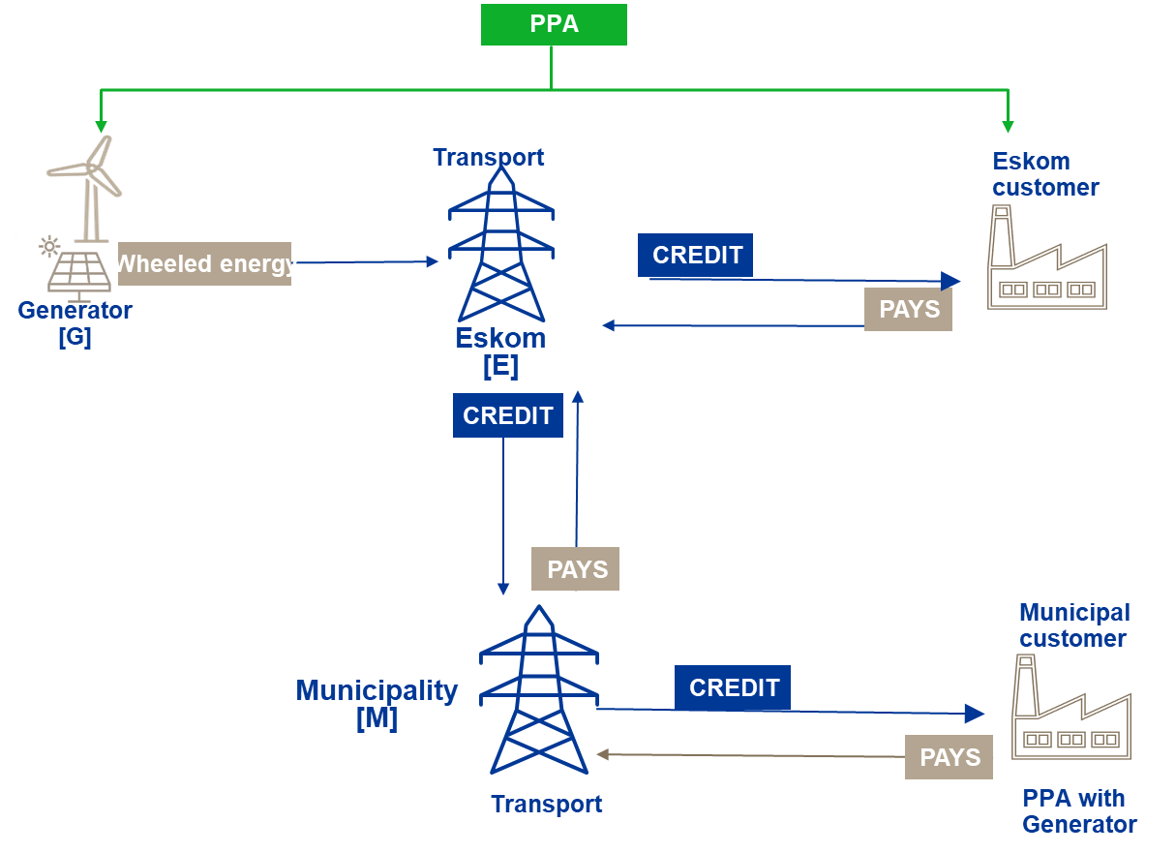
Wheeling tariffs and contracts Wheeling from the Eskom grid to a customer in a municipal licensed area
The generator requires an Eskom Gen DUOS service agreement (SA).
The Municipality must give consent for the wheeling transaction (consent letter from the Municipality to be provided to Eskom)
The wheeled energy credit will be provided to the municipality, the Municipality will then credit the offtaker.
The Gen-wheeling SA is loaded on the Municipal account.
Wheeling to a Municipal customer

Slide 8
Gen-Wheeling tariff FY2026 Tariff
Please refer to Eskom website www.eskom.co.za/tariffs for Eskom latest schedule of standard prices
Note: Eskom may from time to time amend the its tariffs subject to NERSA approval.

Slide 9
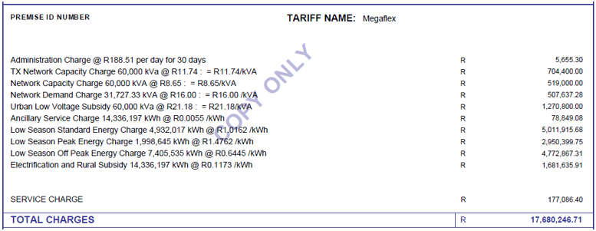
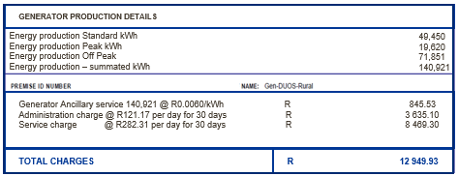
Wheeling bill examples
Normal load tariff charges for the load account
Generator use of system under Gen-DUOS tariff
Credit for wheeled energy provided under a separate Gen wheeling tariff
Only additional charge raised is the Admin charges
Energy produced by a private generator is credited under a separate Gen-wheeling tariff

Slide 10
Available wheeling transactions
1. One generator to one offtaker
The generator will have a Gen DUOS SA A Gen wheeling SA is loaded on the offtaker’s account
Rule: Credit allocated generation but cannot exceed consumption
Gen A
Cust A
Example 1 – One generator wheeling to one offtaker
 | Generator A production (kWh) | Customer A consumption (kWh) | Energy to be used to credit customer A under Gen wheeling | Surplus energy (to be forfeited or can be sold to Eskom)
Peak | 40 000 | 50 000 | 40 000 | 0
Standard | 85 000 | 100 000 | 85 000 | 0
Off-peak | 10 000 | 6000 | 6 000 | 4 000

Slide 11
Available wheeling transactions
2A. One generator wheeling to multiple customers
The generator requires a Gen DUOS Service agreement (SA) Percentage allocation to each offtaker or as nominated by generator. A Gen wheeling SA is loaded on each offtaker’s account
Gen A
Cust A
Rule: Credit allocated generation but cannot exceed consumption
% allocation to each account
Cust B
Example 2A – One generator wheeling to two offtakers - merit order allocation - rule is first allocate to cust A then remainder to cust B
 | Generator A production (kWh) | Customer A consumption (kWh) | Customer B consumption (kWh) | Allocation to customer A (kWh) | Allocation to customer B (kWh) | Energy to be used to credit customer A under Gen wheeling | Energy to be used to credit customer B under Gen wheeling | Surplus energy (to be forfeited or can be sold to Eskom)
Peak | 40 000 | 20 000 | 25 000 | 20 000 | 20 000 | 20 000 | 20 000 | 0
Standard | 90 000 | 50 000 | 50 000 | 50 000 | 40 000 | 50 000 | 40 000 | 0
Off-peak | 10 000 | 4000 | 5000 | 4 000 | 5 000 | 4 000 | 5 000 | 1 000

Slide 12
Available wheeling transactions
2B. One generator wheeling to multiple offtakers - percentage allocation
The generator requires a Gen DUOS Service agreement (SA) Percentage allocation to each offtaker or as nominated by generator. A Gen wheeling SA is loaded on each offtaker’s account
Rule: Credit allocated generation but cannot exceed consumption
Gen A
Cust A
% allocation to each account
Cust B
Example 2B – One generator wheeling to two offtakers - percentage allocation
 | Generator A production (kWh) | Customer A consumption (kWh) | Customer B consumption (kWh) | %Allocation to customer A | %Allocation to customer B | Allocation to customer A based on percentage | Allocation to customer B based on percentage | Energy to be used to credit customer A under Gen wheeling | Energy to be used to credit customer B under Gen wheeling | Surplus energy (to be forfeited or can be sold to Eskom)
Peak | 40 000 | 20 000 | 25 000 | 60% | 40% | 24 000 | 16 000 | 20 000 | 16 000 | 4 000
Standard | 90 000 | 50 000 | 50 000 | 40% | 60% | 36 000 | 54 000 | 36 000 | 50 000 | 4 000
Off-peak | 10 000 | 4000 | 5000 | 50% | 50% | 5 000 | 5 000 | 4 000 | 5 000 | 1 000

Slide 13
End

