Slide 1
State of the System - Summer Outlook Briefing
September 2023

Slide 2
Executive summary
CC
We continue to drive the Generation Operational Recovery Plan with the support of NECOM, Board and Exco to sustainably recover the performance of the plants over the next 24 months
While we have not met the targeted reduction in unplanned load losses, there is a declining trend
Eskom remains committed to increase the amount of available generation, with a specific focus over the summer period, by:
Adding 2880MW¹ from Kusile units (2160MW from U1-3 recovery and 720MW from U5 Synchronisation)
Supporting the system with diesel burn at the open cycle gas turbines (OCGT)
While Koeberg steam generator outage is progressing well and is expected to return on the 3rd of November 2023, it will not make a direct impact on increasing available supply as U2 at Koeberg will be taken off shortly after U1 return
Demand side initiatives of almost 250 MW have been developed to contribute to reducing load shedding
While loadshedding continues to impact the country and the economy, we were able to contain the intensity below the levels that were anticipated in our winter outlook, although we still had to implement stage 6 for 39 days out of a total of 153 days due to higher than expected levels of planned and unplanned outages
Efforts to reduce unplanned load losses need to be intensified in order to avoid significant OCGT usage and meet demand
Eskom is working to contain loadshedding as low as possible, with the aim of not exceeding stage 4 by maintaining unplanned load losses within the 14500 MW scenario for the 2023 summer outlook
1: Refers to nominal capacity, nameplate capacity is 3200MW

Slide 3
Agenda
Generation recovery overview
Demand side management overview
2023 Winter outlook performance and Summer outlook
Conclusion

Slide 4
The Generation Operational Recovery Plan is aimed at sustainably improving performance over time
BN
✓
70% EAF¹
Implementation complete
Implementation in progress
3
World class performance
65% EAF¹
2
Execute excellence
1
Set up for success
Actions for FY25 onwards
Actions for FY24
Return of Medupi 4 from long term forced outage
Commercial operation of Kusile 5
Continuous focus on current and future skills
Ensure successful implementation of Koeberg 2 steam generator and long-term operating projects
Set-up the enabling structures
Turnaround plans
Generation recovery office
Key enablers
Guard performance at current flagship stations
Medupi, Lethabo, Matimba and Peaking
Focus on the Top 6 priority stations
Tutuka, Duvha, Majuba, Kusile Matla, Kendal
Return of Duvha 2 (complete)
Execution of Koeberg 1 Outage
Source external specialized skills
Successful execution of Koeberg 1
Sustain Excellent Medupi performance
Embed principles of Operational Excellence
Address internal skills gaps
Prevent outage slips
Return of Kusile 1, 2 and 3
Synchronisation of Kusile 5
Review plant shutdown dates based on system requirements
Board
Continuous execution of Culture transformation and Strategic Levers as per the Generation recovery plan
Note: 1. MTD for March 2024 and March 2025, Average EAF for the fleet for FY24 of 60%
4

Slide 5
While we have not met the targeted reduction in unplanned load losses, there is a declining trend
BN
FY 2024 expected performance
Actual UCLF+OCLF MW
Target UCLF+OCLF MW
Major improvement primarily driven by Kusile recovery
18 000
17 951
17 000
16 191
16 475
16 162
16 023
15 898
16 084
15 856
16 000
15 261
15 000
14 427
14 868
14 823
14 522
14 444
14 579
14 563
14 000
13 961
13 595
0
Apr
May
Jun
Jul
Aug
Sep*
Oct
Nov
Dec
Jan
Feb
Mar
Stations showing good performance: Camden, Duvha, Hendrina, Lethabo, Majuba, Medupi, Peaking
The performance at the rest of the fleet is below expected levels
Multiple issues have hindered progress on the recovery projection, thus the benefits of MW recovered have not yet been realised
There is a higher level of confidence of meeting the revised summer UCLF+OCLF projection as these primarily based on returning of Kusile units (2 160 MW) with further gains possible through the execution of other stations’ recovery plans
Actual performance against target
Planned major recovery actions to reach targets
In addition to the above, the following initiatives are driven to ensure a step change in unplanned load losses
Project management at a granular level (i.e. actions with associated milestones) of each power stations recovery plan with support from external consultants (WSP) appointed by Eskom board
Driving resolution of key organisational enablers to unlock any bottlenecks and improve business efficiencies
Improve materials management and timeous spares availability
Improve Auxiliary plant performance through maintenance insourcing and limited outsourcing to credible suppliers
*Reflects actual MTD for Sept as of 18 Sept 2023

Slide 6
Progress is being made to recover Generation plant performance
BN
Progress to date
Highlights against the winter outlook
Activated relationship with the Energy Council, and agreement reached on immediate support, encompassing OCGT diesel supply chain, Kusile duct recovery, and power plant support (technical and mentorship of plant managers)
OCGT diesel optimization at Ankerlig and Gourikwa: a private sector team (Energy Council - EC) was deployed and confirmed feasibility of running the Peakers at higher load factors with the following conditions:
Significant additional funding
Predictable load factor plan for all stakeholders to plan and procure for
A guaranteed average offtake by the OCGTs and IPPs which is aligned with the plan
Kusile duct replacement programme: temporary stacks are being erected and the first stack (Unit 3) is 100% complete. Kusile U5 will sync in December 2023. EC team to review the design and methodology for the permanent stacks
Power Station Support. Support teams(EC) to be deployed at Matla, Kriel, Majuba, Kusile, Kendal, Tutuka and OCGT’s
1
Power stations showing consistent performance:
Peaking, Camden, Medupi and Lethabo (Medupi and Lethabo showing above 85% consistent EAF performance)
Stations showing positive improvement trajectory
Duvha, Majuba, Hendrina and Tutuka
EAF peaked at 60% during June¹. Gx last achieved 61.39% in August 2022.
Generation on track to achieve 14500 MW by March 2024
Planned maintenance (PCLF) was maintained at ~3000MW
Lower demand over the weekend continues to be leveraged for opportunity maintenance
2
3
Progress made against the winter outlook has resulted in averting the worst-case scenario of stage 8 loadshedding
Average EAF of 60% was achieved 8 days during June 2023

Slide 7
To recover, we plan to return units on long term outage and to execute major refurbishment projects
BN
Units on long term outage and major refurbishment projects
Key insights
Due to the delays being experienced in replacing the steam generators at Koeberg U1, commercial operation forecast 3 November 2023 and Koeberg U2 Long Term Operation outage starts on 7 November 2023
Kusile Temp Stack erection started ahead of schedule. Kusile U1, 2, 3 & 5 will be synchronised to the grid by December 2023 and will provide 2880 MW
Tutuka RTS dates for Unit 1 & 2 by Jan 2024. Unit 3, 4 & 5 currently on load.
Medupi U4 will be operational in July 2024 with the second-hand stator
Kriel has completed replacement of cooling tower 4 and plan to complete the replacement by March 2024
Majuba has started re-bagging on unit 3 and plan to complete the re-bagging by March 2024
Tutuka has plan to complete the cooling tower replacement by October 2024
Majuba fabric filter plant re-bag and Kriel cooling tower replacement
1752 MW
Tutuka cooling tower replacement
720 MW
Koeberg
900 MW
Kusile
~ 2880 MW
Tutuka
~ 1500 MW
Medupi
~720 MW
Nov 2023
Oct / Dec 2023
Jan 2024
Mar 2024
July 2024
Oct 2024
Notes:
Kusile 720*4 = 2880, however actual output may be lower and gradually ramp up

Slide 8
Agenda
Generation recovery overview
Demand side management overview
2023 Winter outlook performance and Summer outlook
Conclusion

Slide 9
Eskom is focusing on six key areas to deliver 250MW of demand reduction during the FY24 summer period
MB
Overview of demand management initiatives
MW demand reduced
Focus area
Load Shifting/Clipping
Residential load management (RLM)
Energy Efficiency (EE)
Demand Response
Residential Mass roll out (EE)
Total FY24 summer target
1
2
3
4
5
6
MARKETING AND COMMUNICATION SUPPORT
6
Eskom is focusing on 6 areas to deliver 250MW of demand reduction during the FY24 summer period which will assist to alleviate pressure on the electricity system
Some progress to date includes:
Integrated demand management programme being developed with System Operator – In the interim, an incentivised demand management programme was launched in April ’23 - R3m/MW and R0.41c per kWh (proposals are available on the Eskom website)
Exclusion from load-shedding (where technically feasible) is available to customers who meet the load curtailment requirements in line with the NRS 048-9
Customers to support the smart meters rollout to manage supply and demand - enabling energy limiting during constrained periods as opposed to traditional loadshedding i.e., successful launch of Fourways pilot
Educational and behavioural change programmes:
Eskom Energy Efficiency Programmes and Power Alerts driving behaviour change
The Energy Ambassador Programme and the Schools Programme to create awareness on energy savings
Eskom would like to thank customers for the positive response to the winter campaign

Slide 10
In addition to demand reduction, Eskom is also focusing on five other initiatives to relieve pressure on the electricity system
MB
Description
Initiative
Small Scale Embedded Generation (SSEG)
Customers to make safe inverter installations by registering with the utility
Customers can export excess energy and receive a credit – this will incentivise customers to maximise export and add energy to the grid
Microgrids
Eskom deploying microgrids as an alternative to grid-tied solutions – providing further relief to the system
Wheeling
Virtual wheeling and traditional wheeling solutions available to customers and generators to incentivise establishment of generation facilities
Wheeling provides an opportunity for incumbents to invest in new generation capacity and use the Eskom network to prospective off-takers
Standard Offer
In addition to the net-billing offering, the Standard Offer is being offered to the market that allows customers to sell excess energy to Eskom
Community
Co-ops
Collaborative partnerships with various communities in all the provinces to manage their electricity supply and infrastructure. The aim is to reduce electricity theft and vandalism, providing further relief to the system

Slide 11
Agenda
Generation recovery overview
Demand side management overview
2023 Winter outlook performance and Summer outlook
Conclusion

Slide 12
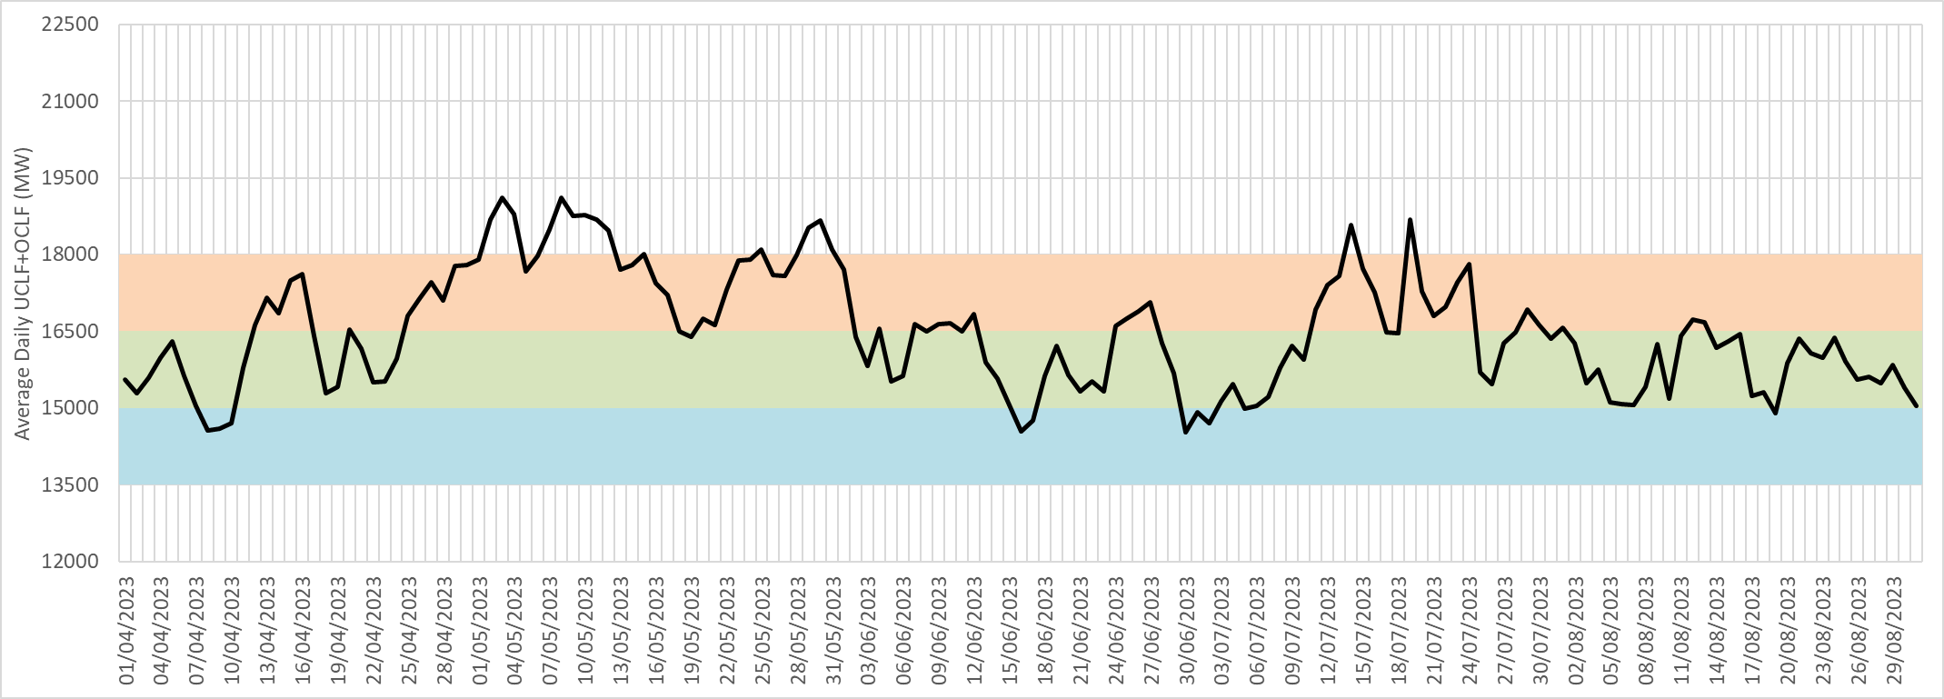
During the winter 2023 period, 43% of hours experienced unplanned losses lower than the assumed worst-case scenario
SS
Overview of unplanned load losses between 1 Apr 2023 and 31 Aug 2023 compared to Winter outlook assumptions
Actual average daily unplanned losses
High unplanned losses assumption
Medium unplanned losses assumption
Low unplanned losses assumption
Insights
The 2023 Winter outlook assumed 3 unplanned load loss scenarios: Base plan: 15GW; Base plan + 1.5GW risk: 16.5GW; Base plan + 3GW risk: 18GW
43% of the hours between 1 Apr and 31 Aug 2023 experienced unplanned losses between 15GW and 16.5GW, which is lower than the assumed worst case from the winter plan
The average unplanned losses over evening peaks was 16 420 MW over the winter period (compared to 16 554 MW for the previous winter)
Eskom has experienced volatility in the system due to unplanned breakdowns although there are indications that unplanned losses are stabilising

Slide 13
While loadshedding continues to impact the country, we managed to contain the intensity below levels anticipated in our winter outlook
SS
Overview of loadshedding intensity and frequency between 1 Apr 2023 and 31 Aug 2023
# of days at various stages¹
Monthly
Total
Stage 2
Stage 3
Stage 4
Stage 5
Stage 6
30
31
30
31
31
1
1
1
1
1
1
Apr-23
May-23
Jun-23
Jul-23
Aug-23
Eskom has needed to implement loadshedding everyday between 1 Apr 2023 and 31 Aug 2023 due to insufficient generating capacity to meet demand
The highest intensity of loadshedding was implemented during May 2023 due to high demand and high unplanned outages, followed by Apr 2023 due to higher levels of planned and unplanned outages
In the period there has been 153 days of loadshedding, with the majority of days experiencing a maximum of stage 3 (55 days), stage 4 (42 days) and stage 6 (39 days) loadshedding
Despite not having the Kusile units and winter prediction of stage 8, we kept the loadshedding stages at a maximum of stage 6
Source: 2023 Load Shedding and Curtailment events Notes: 1: Indicates maximum stage per day

Slide 14
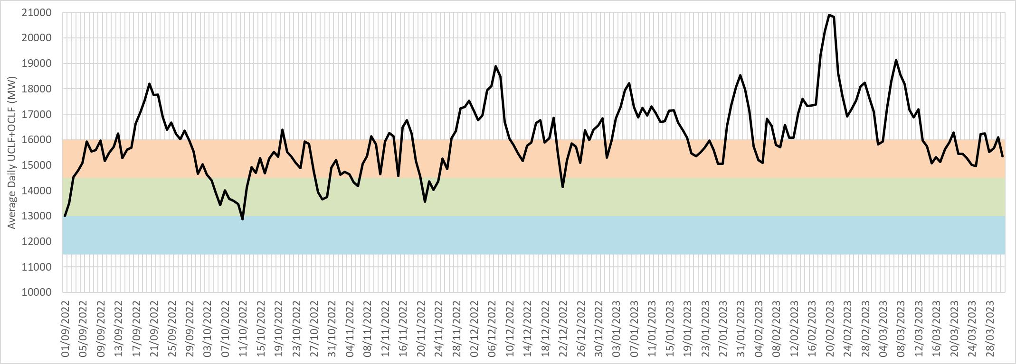
To create a more realistic current summer outlook projection, historical performance trends were considered
SS
Overview of unplanned load losses between 1 Sept 2022 and 31 Mar 2023 compared previous Summer outlook assumptions
High unplanned losses assumption
Medium unplanned losses assumption
Low unplanned losses assumption
Insights
The previous summer outlook assumed unplanned losses between 13GW and 16GW while the majority of actual unplanned losses experienced for the period ranged between 14.5GW and 17.5GW
As a result, the current summer outlook assumes between 14.5GW and 17.5GW unplanned losses (a conservative view factoring in previous' summer performance)
The current assumptions (informed by previous summers’ performance) and the Gx recovery initiatives instill confidence that the current summer outlook can be achieved

Slide 15
Eskom is working to contain loadshedding as low as possible, with the aim of not exceeding stage 4 by maintaining unplanned load losses within the 14500 MW scenario
SS
Summer 2023-24 – 1 September 2023 to 31 March 2024 (213 days)
Scenarios |  | 14 500 MW UCLF |  | 16 000 MW UCLF |  | 17 500 MW UCLF
Number of loadshedding days |  | 116 Days |  | 187 Days |  | 211 Days
Highest stage of loadshedding |  | Stage 4 |  | Stage 6 |  | Stage 7
Month | Peak Residual Forecast | Load reduction days | Max load reduction stage | Load reduction days | Max load reduction stage | Load reduction days | Max load reduction stage
September | 30,017 | 18 | 3 | 29 | 6 | 30 | 7
October | 29,039 | 19 | 4 | 28 | 5 | 31 | 6
November | 28,538 | 14 | 4 | 25 | 5 | 30 | 6
December | 27,927 | 11 | 4 | 23 | 5 | 31 | 6
January | 28,214 | 18 | 4 | 26 | 5 | 31 | 6
February | 28,704 | 17 | 4 | 29 | 5 | 29 | 6
March | 29,006 | 19 | 4 | 27 | 5 | 29 | 6
Target scenario
Other assumptions: An operating reserve of 2200MW is maintained in the system, ~1000MW from spinning reserve and 1200MW from Interruptible Load Shed and Demand Response levers; Total planned outages of between 3749MW and 9533MW expected (averaging 6201MW for the period); Gas planned outages between 148MW and 444MW, averaging ~185MW for the period; Assumes ~1250MW import capacity depending on forecasted availability

Slide 16
Agenda
Generation recovery overview
Demand side management overview
2023 Winter outlook performance and Summer outlook
Conclusion

Slide 17
In conclusion:
CC
Eskom would like to apologise to all South Africans for the negative impact caused by the implementation of loadshedding
We understand the impact loadshedding has on the economy and on the livelihood of all South Africans, however loadshedding is implemented to maintain the stability of the national power system to avoid a blackout
The immediate summer outlook indicates that loadshedding can be contained within stage 4, if we manage our unplanned load losses within 14500MW
The addition of 2880MW from Kusile will be critical towards closing the gap between supply and demand
We will continue to implement the Generation Recovery Programme which will sustainably improve the performance of our plants
Lower levels of loadshedding should be expected towards the end of the year and early 2024
The biggest impact we can all make as a nation is to use electricity sparingly, especially during the peaks

Slide 18
END

