Slide 1
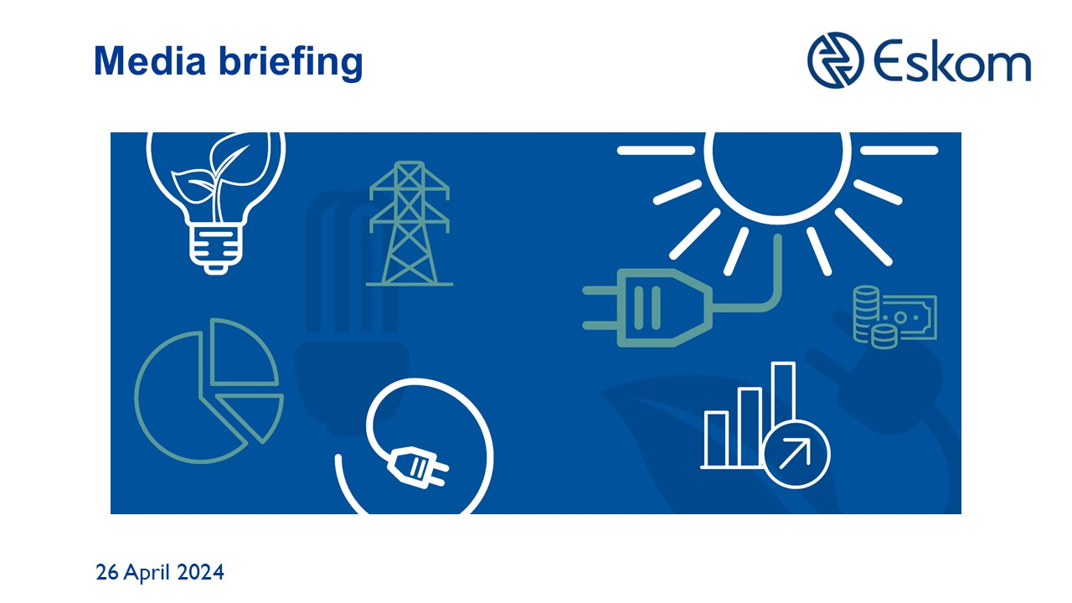

Slide 2
State of the System - Winter 2024 Outlook Briefing
Dan Marokane
April 2024

Slide 3
Key Takeaways
The Winter 2023 performance was within the forecast frequency range - load shedding mostly contained between stages 2 and 4
The Generation Recovery Plan – focusing on people, plant performance and processes & governance gained traction from the beginning of Winter 2023 and is executed by Eskom in collaboration with NECOM structures.
Between April 2023 and March 2024, the reliability of the power plants is showing improvement on the back of the of the Generation Recovery Plan, with a YoY improvement of 9% in unplanned losses, and 19% decline in unit trips
Since April 2023 to date, the frequency and the intensity of loadshedding has declined as should be expected as the Generation Recovery Plan execution progresses.
NO loadshedding for 30 consecutive days – with the diesel spend 50% lower than the spend in the same month last year. FY25 load factor of 9% compared to that of 18% in FY24.
There is a considerable shift in the unreliability assumption for Winter 2024 forecast – a 1000 MW downward revision
For Winter 2024, the likely scenario indicates that loadshedding will be limited to Stage 2
Over the winter period, targeting a further 1.7GW from reduction in unplanned losses (1.3GW) and driving Demand management initiatives (382MW)
Ending load shedding is a collective effort and we will be counting on your support for our energy saving campaign in the month of May
#WeCanEndLoadsheddingTogether

Slide 4




Our approach to this Winter 2024 outlook briefing
Recap on the winter 2023 outlook and performance
Set the context for this winter 2024 outlook
Provide an update in tackling unreliability of the units
4

Slide 5
The actual system performance for Winter 2023 was within the forecast range
Winter 2023 – 1 April 2023 to 31 August 2023 (153 days) |  | Winter 2023 – 1 April -31 August (153 days)
Scenarios |  | Base case: 15 000 MW UCLF |  | Base case +1500MW : 16 500 MW UCLF |  | Base case + 3000 MW 18 000 MW UCLF
Number of LS days OCGT costs |  | 122 Days R 12.1bn |  | 152 Days R 12.5bn |  | 153 Days R 12.5bn
Highest stage of LS |  | Stage 5 |  | Stage 6 |  | Stage 8
Month | Peak residual forecast | Load reduction days | Max load reduction stage | Load reduction days | Max load reduction stage | Load reduction days | Max load reduction stage
May | 32 499 | 27 | 5 | 31 | 6 | 31 | 7
June | 32 572 | 18 | 3 | 30 | 6 | 30 | 7
July | 32 378 | 28 | 5 | 31 | 6 | 31 | 8
August | 31 413 | 28 | 5 | 31 | 6 | 31 | 8
Average actual unplanned losses were around 16.5GW and the majority of the loadshedding was contained to stages 3 and 4 (with a maximum of stage 6)

Slide 6
Since last winter, Eskom’s investment in maintenance and disciplined execution of the recovery plan has resulted in a gradual reduction of unplanned losses
Gx actual performance on unplanned losses²
GW
Actual ~ unplanned losses
-9%
18,0
16,2
16,0
16,5
15,9
15,8
14,5
16,2
13,7
14,6
14,7
14,8
Apr-23
May-23
Jun-23
Jul-23
Aug-23
Sep-23
Oct-23
Nov-23
Dec-23
Jan-24
Feb-24
Mar-24
2023 Winter outlook period
2023/24 Summer outlook period
Downward trend in unplanned losses especially at the priority 6 stations (Tutuka, Majuba, Kusile, Kendal, Matla, Duvha):
  Year-on-year overall unit trips are declining, indicating the fleet is becoming more reliable – 19.2% reduction between FY23 vs. FY24
  Return of 4 Kusile units: U1-3 that were impacted by the flue duct collapse which have been recovered and U5 has been synchronised to the grid
  Multiple projects are in progress to reduce Partial Load Losses – e.g. cooling tower refurbishments at Kriel and Tutuka, re-bagging at Majuba
Current unplanned losses of 14.2GW (~30%) are however still unsustainable hence the target is to reduce load losses to below 14GW¹
Source: State of the system outlooks; Eskom Public Data Portal
Note 1: The targets for FY25 is still under review; 2: UCLF+OCLF. Gx – Generation, UCLF – Unplanned Capability Loss Factor

Slide 7
The continuing improvement in Generation plant performance and the accompanying reduced loadshedding intensity has informed our updated outlook
Overview of loadshedding intensity and frequency between April 2023 and March 2024
# of days at various stages¹
Stage 1
Stage 2
Stage 3
Stage 4
Stage 5
Stage 6
2023 Winter outlook period
2023/24 Summer outlook period
30
31
30
31
31
30
30
2
1
1
1
2
1
28
29
1
1
26
1
20
1
1
13
2
2
2
2
0
1
Apr-23
May-23
Jun-23
Jul-23
Aug-23
Sep-23
Oct-23
Nov-23
Dec-23
Jan-24
Feb-24
Mar-24
Apr-24
Eskom implemented loadshedding on over 90% of the days between April 2023 and March 2024, though there is a clear decreasing trend and the majority of loadshedding has been contained to between stages 2-4
The return of Kusile units ahead of schedule and recovery of unplanned load losses assisted in reducing the frequency and intensity of loadshedding in the FY2024 summer period
Eskom has not implemented loadshedding for 30 consecutive days
7
Source: 2023/2024 Load Shedding and Curtailment events Notes: 1: Indicates maximum stage per day

Slide 8
Winter 2024 loadshedding forecast to be within stage 2
Likely scenario
Winter 2024 – 1 April 2024 to 31 August 2024
Scenarios |  | Base Case: 14 000 MW unplanned outages |  | Base Case + 1500MW: 15 500 MW unplanned outages |  | Base Case + 3000MW: 17 000 MW unplanned outages
Number of LS days Diesel costs |  | 5 Days R 3.3bn |  | 65 50 Days R 8.8bn |  | 128 103 Days R 16.0bn
Highest stage of LS |  | Stage 1 |  | Stage 2 |  | Stage 5
Month | Peak Residual Forecast | Load reduction days | Max load reduction stage | Load reduction days | Max load reduction stage | Load reduction days | Max load reduction stage
April | 29,354 | 0 √ | 0 | 15 0 | 2 0 | 25 0 | 5 0
May | 31,205 | 0 | 0 | 10 | 1 | 23 | 2
June | 32,204 | 2 | 1 | 8 | 2 | 22 | 5
July | 32,182 | 0 | 0 | 19 | 2 | 31 | 5
August | 31,336 | 3 | 1 | 13 | 2 | 27 | 5
Considerable change in performance showing a recovery of 1000 MW has improved our confidence
With unplanned losses maintained between 14GW-15.5GW, loadshedding intensity over the Winter period is anticipated to be contained within stage 2, with a worst-case scenario of stage 5 at unplanned losses of 17GW
8
LS - Loadshedding

Slide 9
Agenda
Generation recovery overview
Demand management overview
Conclusion
9

Slide 10

Execution of the Generation recovery plan initiatives has led to a considerable improvement in plant performance
70%¹ EAF
  Implementation complete
  Implementation in progress
3
World class performance
65%¹ EAF
2
Execute excellence
1
Set up for success
Actions for FY25 onwards
Actions for FY24
  Return of Medupi 4 from long term forced outage (Sept 2024)
  Commercial operation of Kusile 5 (Jun 2024)
  Synchronisation of Kusile 6 (Oct 2024)
  Continuous focus on current and future skills
  Ensure successful implementation of Koeberg 2 steam generator and long-term operating projects (Sep 2024)
  Set-up the enabling structures
    Turnaround plans
    Generation recovery office
    Key enablers
  Guard performance at current flagship stations
    Medupi, Lethabo, Matimba and Peaking
  Focus on the Priority stations
    Tutuka, Duvha, Majuba, Matla, Kendal, Arnot, Kriel, Koeberg
    Kusile removed from priority list
  Execution of Koeberg 1 Outage
  Source external specialized skills
  Successful execution of Koeberg 1
  Sustain Excellent Medupi performance
  Embed principles of Operational Excellence
  Address internal skills gaps
  Prevent outage slips
  Return of Kusile 1, 2 and 3
  Synchronisation of Kusile 5
  Review plant shutdown dates based on system requirements
Board
Continuous execution of Culture transformation and Strategic Levers as per the Generation recovery plan
Note: 1. MTD for March 2024 and March 2025
10

Slide 11


Eskom has managed to increase plant availability and decrease spend on expensive OCGT generation, especially across Mar and Apr 2024
Unplanned losses %
Planned losses %
Available %
    Gx monthly performance: March – August 2023
    Gx Weekly performance: March – April 2024²
33.2
31.9
32.2
30.2
31.5
29.3
29.8
28.6
34.5
34.7
38.7
34.4
35.3
34.1
13.0
11.1
12.0
11.9
10.2
13.2
14.4
13.9
10.9
13.7
7.8
7.4
7.6
9.6
61.2
53.6
53.6
53.9
56.8
57.3
58.7
58.3
54.6
51.5
53.5
58.2
57.1
56.4
2024/03/04
2024/03/11
2024/03/18
2024/03/25
2024/04/01
2024/04/08
2024/04/15
2024/04/22
Mar’23
Apr’23
May’23
Jun’23
Jul’23
Aug’23
1.2
0.8
1.2
0.05
0.04
0.4
0.45
0.46
2.1
3.1
4.2
2.3
3.1
2.1
1.4
R’bn¹
3.3³
Eskom’s plant availability has been trending upwards, especially for Mar and Apr 2024, supported by decreasing unplanned losses
The increased availability has supported decreasing spend on expensive OCGT generation
OCGT are part of the energy mix utilized for meeting peak demand as required by the system operator
Notes:
1: Draft numbers, still to be audited 2: unplanned losses includes OCLF; 3: Includes 1-3 March spend
xx
Denotes Eskom and IPP OCGTs MTD and WTD actual costs
11

Slide 12
Beyond the winter period, units on long term outages and the remaining Kusile units will be brought online as part of the Recovery Plan
Key insights
  Units on long term outage - return dates
Kusile - Kusile units 1 to 3 (with temporary stacks) were returned to service ahead of schedule by end 2023.
Additionally, Kusile U5 synchronised to the grid on 31 December 2023. Post sync unit optimisation to full load is progressing
Kusile U6 is planned to first synchronise by Oct 2024
Tutuka RTS dates
Unit 4 planned outage for Low Pressure turbine rotor and HPH replacement, return to service (RTS) end April 2024
Unit 5 on Major outage with RTS April 2024.
Medupi U4 is planned to be operational in September 2024 with the second-hand stator. Stator arrived in South Africa in February and arrived at Medupi on 5 March.
Koeberg U2 outage started on 11 December 2023, estimated completion is September 2024
Kusile 6 1st Sync
~ 800 MW
Koeberg U1
~ 930 MW
Kusile* U1, 2, 3, 5
~ 3200 MW
Tutuka 1,2, 4, 5
~ 1500 MW
Medupi U4
~794 MW
Koeberg 2
~930 MW
Nov 2023
Dec 2023
Apr 2024
Sept 2024
Sept 2024
Oct 2024
Units 3, 1 and 2 have been returned to the grid and are providing power up to 2400 MW
Unit 5 post sync optimisation to 800 MW full load is in progress
Unit 1 completed on 12 Jan 2024
Unit 2 returned on 27 December 2023.
1. Data as at 25 Mar 2024; LP: Low pressure; HPH: High-pressure heaters; RTS: Return to service
Notes:
Kusile 720*4 = 2880, however actual output may be lower and gradually ramp up

Slide 13
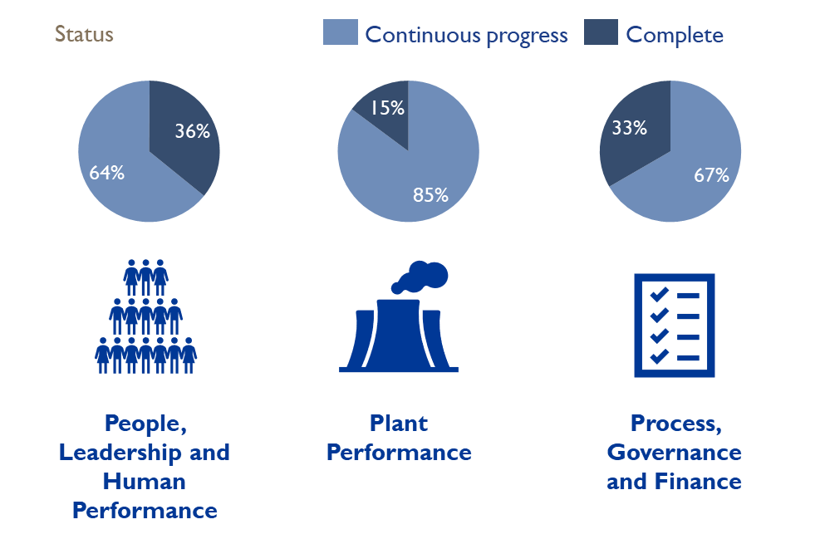
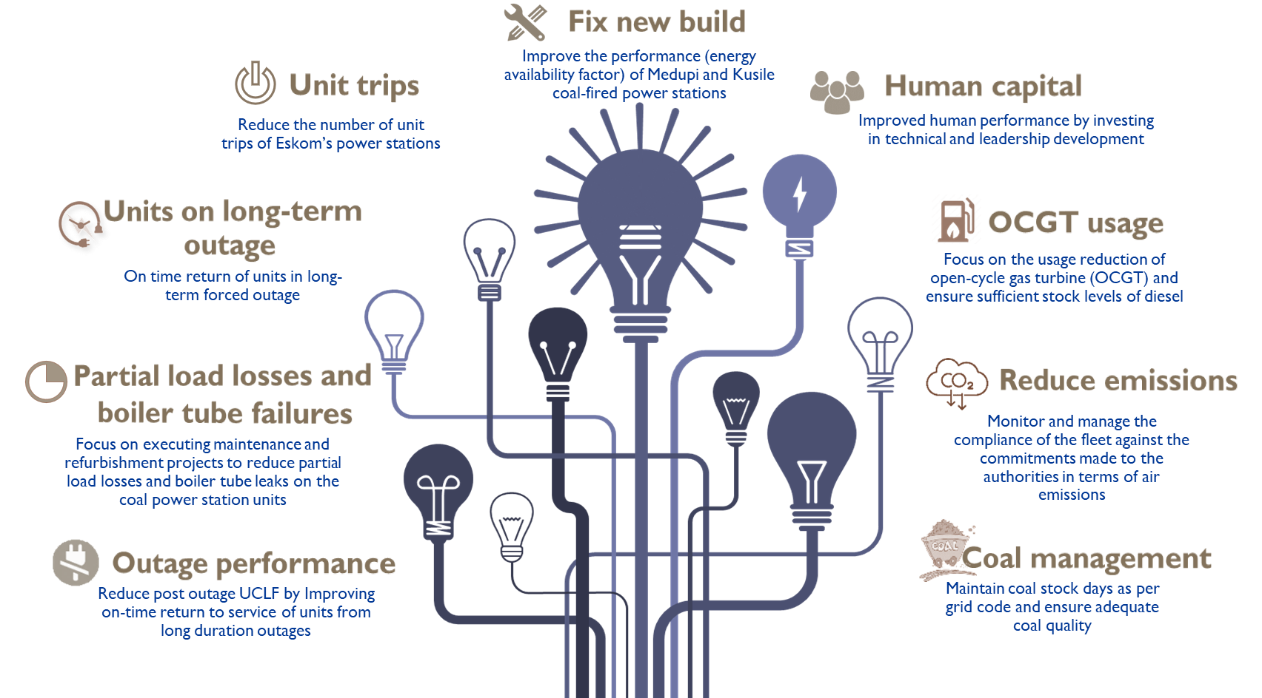
Recommendations from the independent reviews including the recent VGBe report have been incorporated into the Gx Recovery Plan
Dec 2018
Ministerial Technical Review Team
DPE led team to conduct a technical review of Eskom’s baseload fleet performance
Dec 2020
Initiatives in progress from independent reviews
Timeline for the independent reviews
Ministerial Technical Review Team (II)
DPE led review, with a focus on assessing the Eskom EAF recovery plan (9 Point plan)
World Bank
World Bank independent review of the issues associated with declining EAF performance
Mar 2023
9 Point plan approved
May 2019
Approval of the Gx Recovery Plan
Establishment of the Recovery office to actively provide oversight to the recovery plans per station
Jan 2024
VGBE Report
National treasury assigned VGBE to conduct an independent assessment of Eskom's operational situation
WSP
The Eskom Board appointed WSP in March ‘23, to independently review and stress test the effectiveness of the current Gx Recovery Plan
Sep 2022
Key successes
Improved collaboration with OEMs and NECOM for capacity building
Optimised internal and external procurement processes
Outage readiness improvement as a result of sufficient budget allocations
Aug 2023
MTRT – Ministerial Technical Review Team, WB – World Bank, VGBe – VGBe Energy IS US, NECOM – National Energy Crisis Committee

Slide 14


Key enablers are being implemented to ensure that the Recovery Programme is sustainable
  Implementation complete
✓
  Implementation in progress
Enablers and progress status
Leadership Stability
  Delayered and stabilised leadership team by closing critical vacancies (Appointment of Gx GE, critical PSGM vacancies, removing cluster structure)
  Executive coaching and psychosocial supported via EmpowerU intervention
  Implemented Management Development, Technical training and authorisations (GTLP and MDP implemented with over 40 individuals over three years in the program; technical training reinstated through EAL with 11 Gx artisans currently involved; Top Talent and Millennials programs instituted)
Critical Vacancies
  Closed critical vacancies through crowdsourcing and recruitment - focus on Engineering, Operating, Maintenance, Commissioning and Procurement (since Apr 2023; over ~2500 vacancies closed either through external appointments or internal promotions)
  Industry support on priority stations and general technical support on valves, pumps, waste water recovery system, and coal conveyors
Maintenance & Inventory Management
  Prioritised insourcing of critical maintenance with labour support and limited outsourcing to credible service providers
  Establishment of inventory management and recovery team for turbine, boiler, and auxiliary plant (ERI actively implementing recovery plan to improve quality of service; barcoding system piloted at Duvha for improved inventory management)
Government Support
  Leveraging other SOE support - Engaging Denel to leverage state capability on security and SAA on technical support for gas turbines
  Gained environmental exemption to allow for Kusile U1, U2 and U3 to operate at full capacity with temporary stack (returned all 3 units to service during 2023 to support the grid)
  Minimum emissions appeal to DFFE for multiple power stations (Awaiting DFFE feedback)
  Government support for Eskom’s participation in clean energy investments to support RE growth, e.g. gas and pumped hydro storage and nuclear schemes
14
PSGM – Power Station General Manager; GTLP – Generation Technical Leadership Program; EAL – Eskom Academy of Learning; ERI – Eskom Rotek Industries

Slide 15
Agenda
Generation recovery overview
Demand management overview
Conclusion
15

Slide 16
Demand management initiatives with a target of ~382 MW have been identified for the 2024 winter period
Overview of Demand Management initiatives
Projected MW demand reduced
Beyond the winter outlook, Distribution will be driving initiatives worth 2282MW in the next 12 – 18 months, which include:
  Residential load management from Metros (432 MW)
  Load Limiting (1850 MW)
Energy Efficiency
Load Management
Load limiting
Additional Supplemental Demand Response (SDR)
Total additional DSM in 2024 winter period
Eskom is focusing on 4 areas to deliver 382MW of demand reduction during the 2024 winter period which will assist to alleviate pressure on the electricity system. This is over an above the cumulative demand savings of 4 800 MW achieved since the program was initiated in 2005
Some progress to date includes:
  Successful deployment of 50MW load limiting through smart meters and to achieve + 150MW within the 2024 winter period
  An incentivised demand management programme launched April ’23 - R3m/MW for load management and R0.41c/kWh for energy efficiency
Deployment of Eskom Energy Efficiency Programmes and Power Alerts driving behaviour change
Working together with municipalities to address ongoing infrastructure theft, vandalism and overloading – over 1000 isolated/ failed transformers throughout the country.
16

Slide 17
In addition to demand reduction, Eskom is also focusing on five additional initiatives to relieve pressure on the electricity system
Description
Initiative
Small Scale Embedded Generation (SSEG)
  Incentivising customers to export excess energy and receive a credit to add energy to the grid
  Efforts being undertaken to encourage customers to make safe inverter installations by registering with the utility - 429 systems with an equivalent capacity of 254 MW has been authorised to date
  Battery energy storage commissioned with another 5 under construction and 2 in procurement
Microgrids
Deploying microgrids as an alternative to grid-tied solutions, providing further relief to the system
20 microgrids installed over 2023/4 with a target of 33 over 2024/5 financial year
Wheeling
  Driving virtual wheeling and traditional wheeling solutions to incentivise establishment of, and investment into generation facilities
Standard Offer
  Developed Standard Offer program that allows customers to sell excess energy to Eskom – 16 projects with a total capacity of 66 MW in the pipeline
Community
Co-ops
  Driving collaborative partnerships with various communities in all the provinces to manage their electricity supply and infrastructure with the aim of reducing electricity theft and vandalism, providing further relief to the system
17

Slide 18
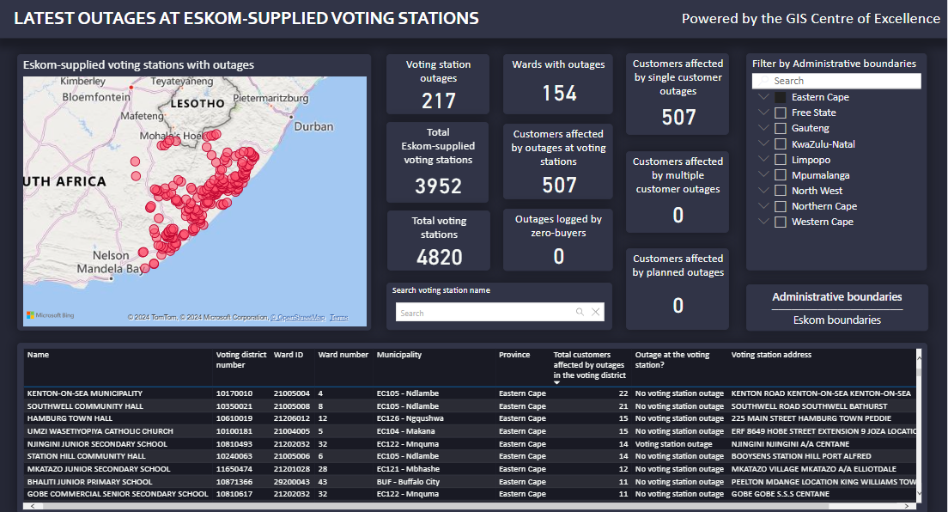
Eskom is working with the IEC to ensure that adequate plans are in place to ensure electricity supply
Election Preparations
Operational plan
  Distribution Tactical Command Centre is co-ordinating Distribution preparedness for the elections.
  Distribution Provincial Elections co-ordinators appointed.
  Engagements with external stakeholders (National and Provincial IEC) have commenced.
  Memorandum of understanding between Eskom and IEC concluded and has been signed off from Eskom side.
Outages and Maintenance
  Unplanned outages affecting voting stations will be escalated and prioritised in terms of dispatching.
Emergency Response Structures will be activated when necessary
  Provincial Joint Command Centre's (PJCC’s).
  Distribution Tactical Command Centre.
Situational awareness structures and Eskom’s presence at IEC results centres
  Situational awareness structures at Provincial and National levels will be activated during election period to provide information to stakeholders in relation to total systems capacity and continuity of supply at the voting stations
Voting Station Dashboard Link
Voting Stations Per Province

Slide 19
Agenda
Generation recovery overview
Demand management overview
Conclusion
19

Slide 20
In Conclusion
We have seen a positive trend in the reduction of unplanned load losses leading to the reduction in loadshedding intensity and frequency over the FY24 summer period
The winter outlook likely scenario indicates loadshedding will be limited to stage 2, given improvement in the generation fleet performance since last winter outlook
Through disciplined execution and single-minded focus on our Generation Recovery Plan, we expect loadshedding intensity to continue to reduce
We appreciate the efforts of our employees and the NECOM partnership for their contribution towards reducing the intensity of loadshedding
The biggest impact we can all make as a nation is to use electricity sparingly and encourage participation in the energy saving initiatives during the month of May (Energy saving month)
We understand and apologise for the negative impact that loadshedding has had on the South African people, but we remain steadfast in our plan to overcome it

Slide 21
